Slide 1

Introduction
Exponential scientific data growth
CPU computer power cannot keep up
Huge emerging gap between researchers and results
Big problems will remain unanswered
Less investment in computing equipment, more in staff

Slide 2
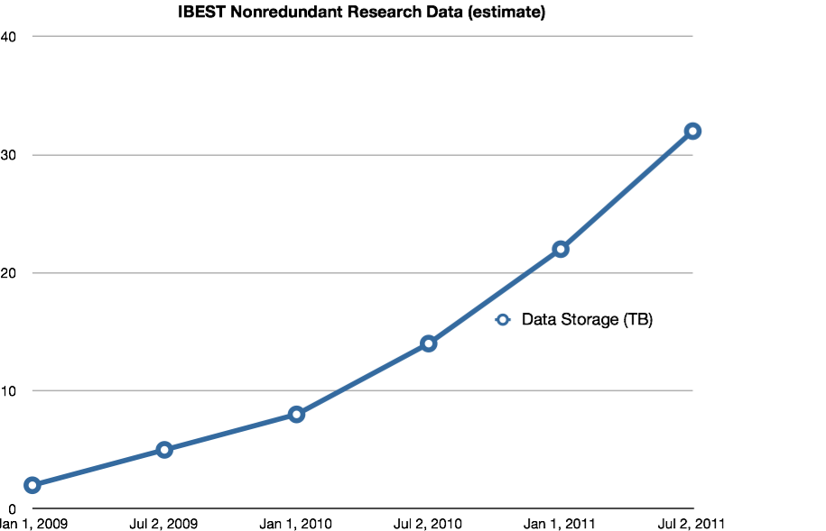
Exponential data growth
Doubling every 2 years [1]
U of I IBEST data is ~33 TB, growing
<10% data used in final research [2].
[1] Szalay, Alex; Gray, Jim. “2020 Computing: Science in an exponential world”. Nature 440, 413-414 (23 March 2006)
[2] Foster, James. Visualizing Human Microbiome Ecosystems. University of Idaho: Computer Science Colloquium, December 7th 2010. Seminar.
Text

Slide 3
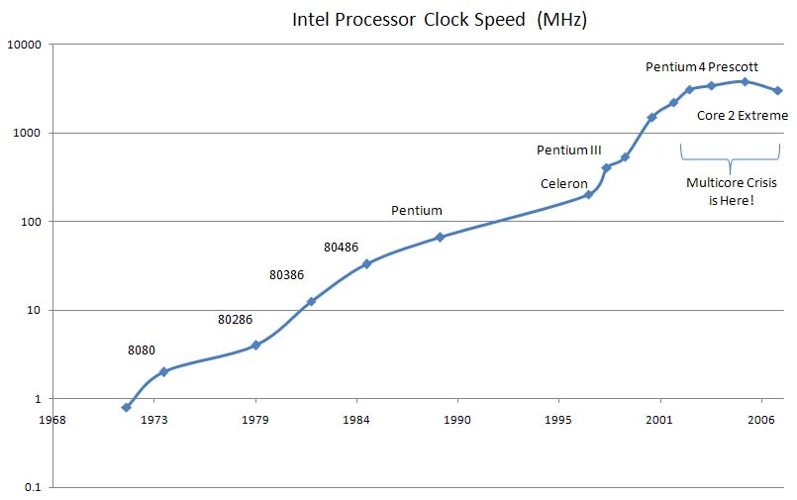
The death of Moore’s Law
Back in 1965, Moore’s Law declared [3]
Transistors density doubled every 2 years
CPU power roughly the same
Growth continued for 40 years
Transistors approach to size of atom
Who boldly declared the law dead?
Text
Text
[3] Manek Dubash (2005-04-13). ”Moore’s Law is dead, says Gordon Moore”. Techworld. Retrieved 2006-06-24

Slide 4
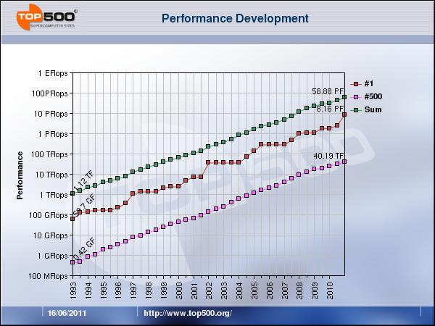
CPU Chips cannot keep up
High Performance Compute Clusters
Groups of computers, one huge CPU
Amazingly powerful and complicated

Slide 5
Conclusion
Dire need of more processing power
Data collection eclipsed by the inability to analyze it
Big answers lie in the balance
Data deluge will hold back advances
People disciplined in computers are needed
NSF and NIH grants favor funding data collection
Actually analyzing the data
Research will become less and less meaningful

